Slide 1
Home Owl
Autonomous Security Robot
Samantha Buckle
Dylan Dauz
Sameeh Olipani
Sheldon Peters

Slide 2
Problem
Homes, businesses, and facilities become vulnerable at night to break-ins or intrusions
On average, 3,062 burglaries happen in the U.S. every day
Full security systems are:
Semi-permanent
Costly
Can take time to install
Notes:
same

Slide 3
Project Goals
This project aims to design and build a robot for use in the monitoring of indoor spaces
Robot will be capable of:
Autonomous navigation of a building or room without the need for human control
Utilize sensors to detect loud noises or the presence of a person
Flash lights and play an alarm sound when disturbance is detected
Get signal from remote control to turn the system on and off
Notes:
same

Slide 4
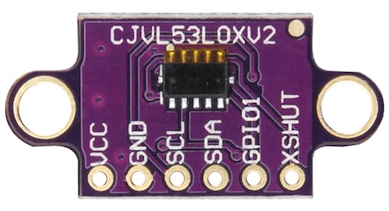
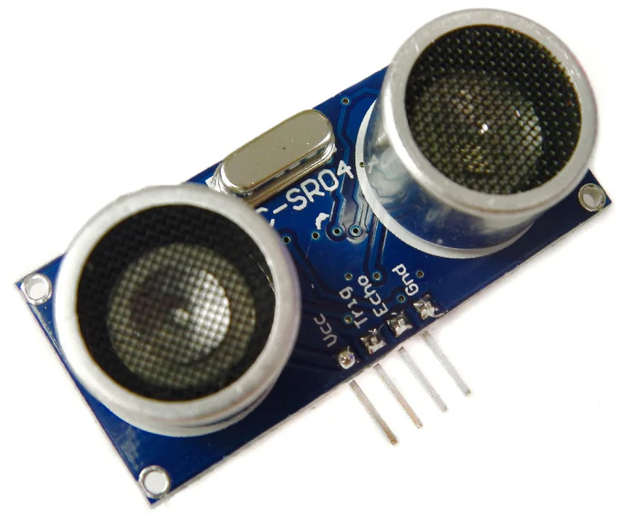
Sensor Testing
VL53L0X (ToF) vs HC-SR04 (Ultrasonic Sensors)
Distances are both in our desired detection ranges
Using multiple ultrasonic sensors requires interval pinging
Connecting multiple ToF sensors requires using the xshut
Final decision on which one we will be using is the ToF
Notes:
sheldon

Slide 5
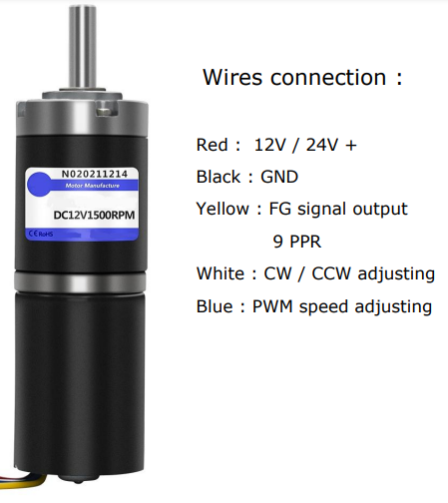
Motor Issues
Our group acquired the new motor controllers and tested them, but we ran into the issue of not interfacing between the motor and arduino
We found out the motors have built in hall encoders and PWM speed control
Therefore the motor plugs directly into the elegoo mega
Notes:
sheldon

Slide 6
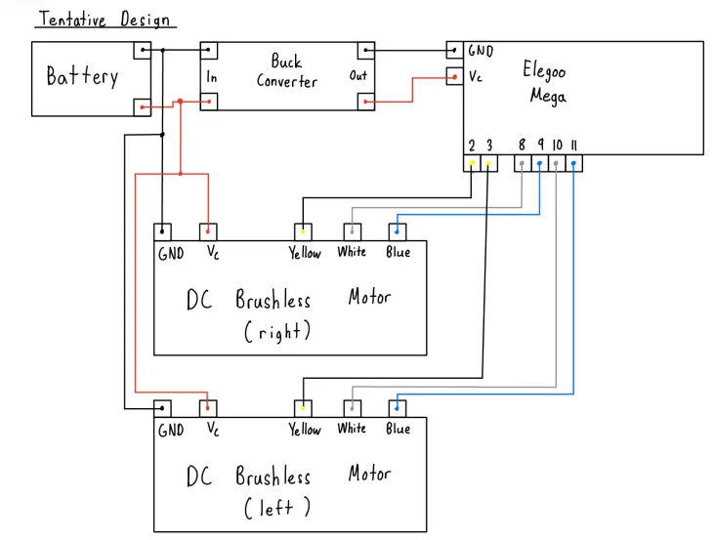
Wiring Diagram

Slide 7
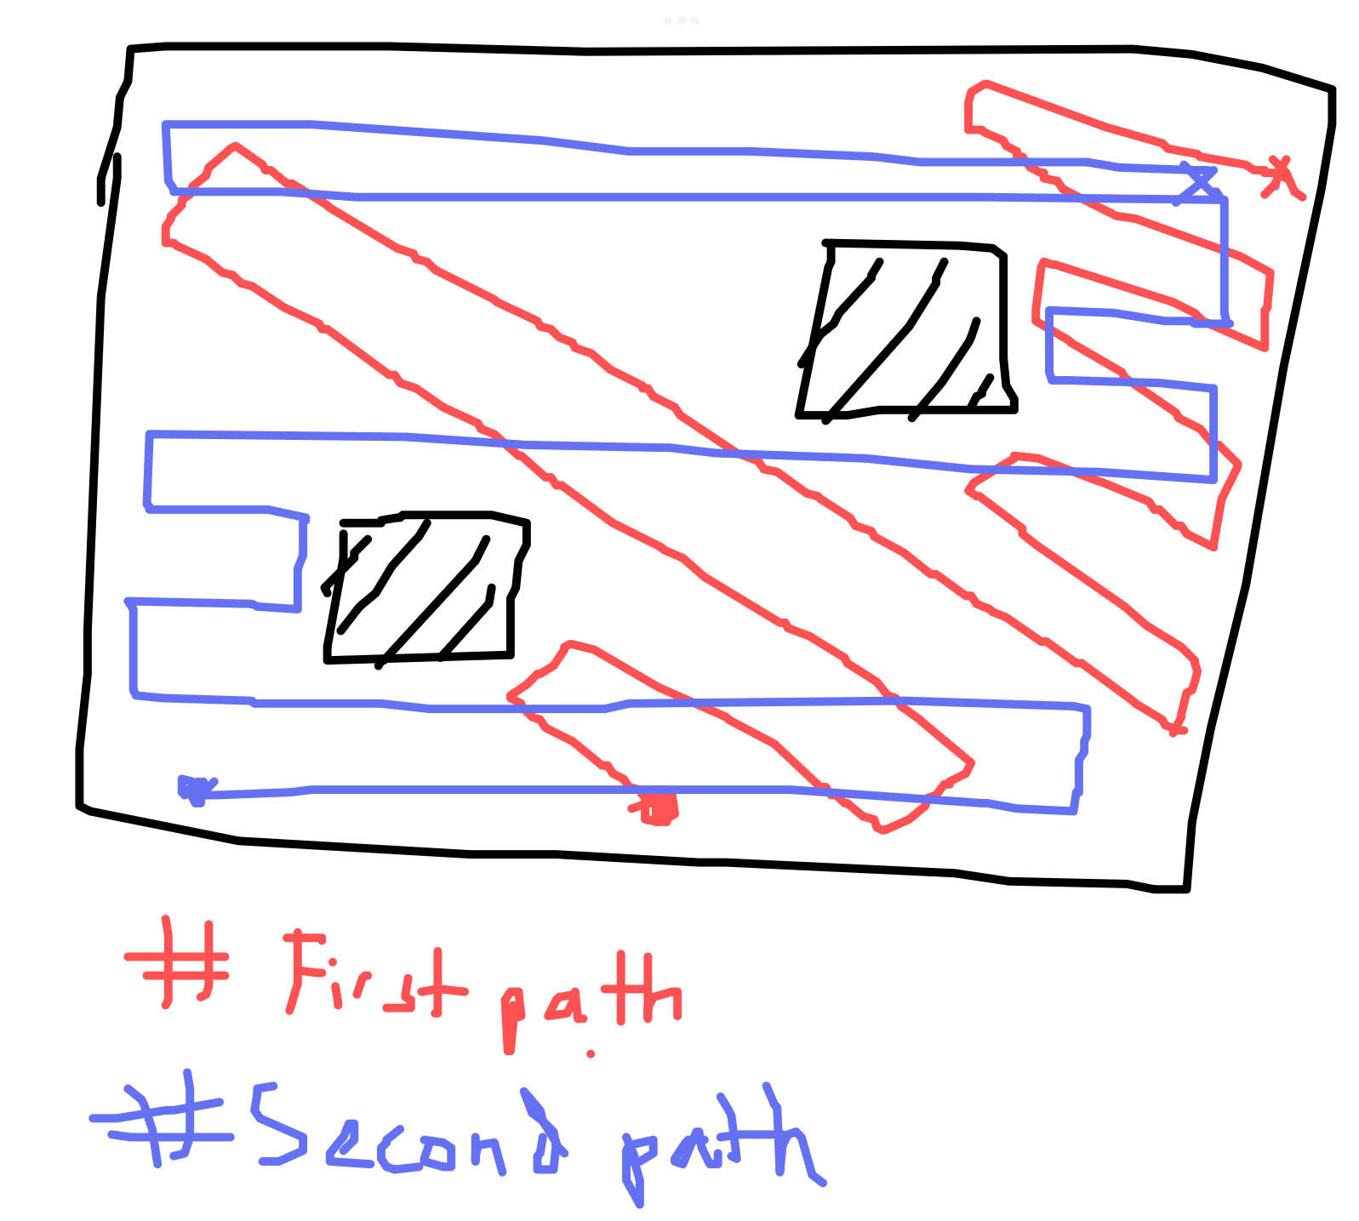
Movement Algorithm
------------------- START MOVING -----------------
Navigation Loop (10-15 sec)
Check for obstacle
Move through room using ToF sensor
Turning with PID: use gyro to get current angle & turn to desired angle
------------------- STOP MOVING -------------------
Sense Loop (5 sec)
Sense sound
Sense for motion using PIR
If motion then alarm, light, ect
----------------- RESUME MOVING ----------------
Note: Changes will come to update this movement

Slide 8
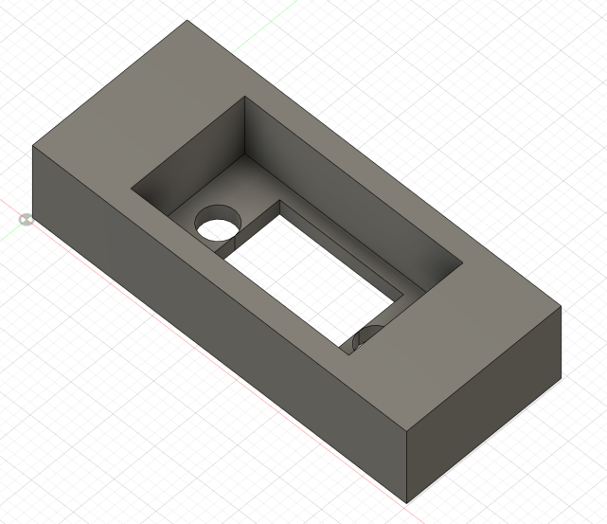
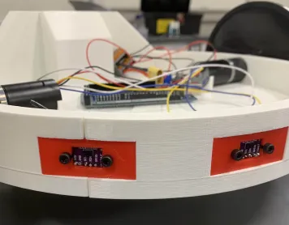
ToF Sensor Casing Model
Notes:
dlyan

Slide 9
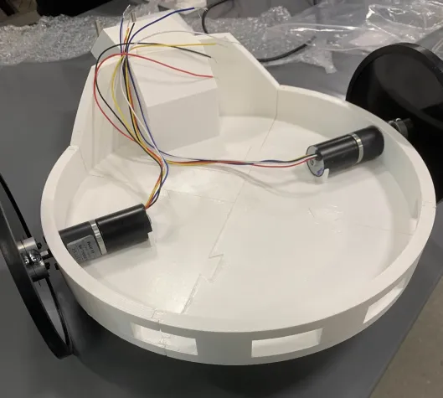
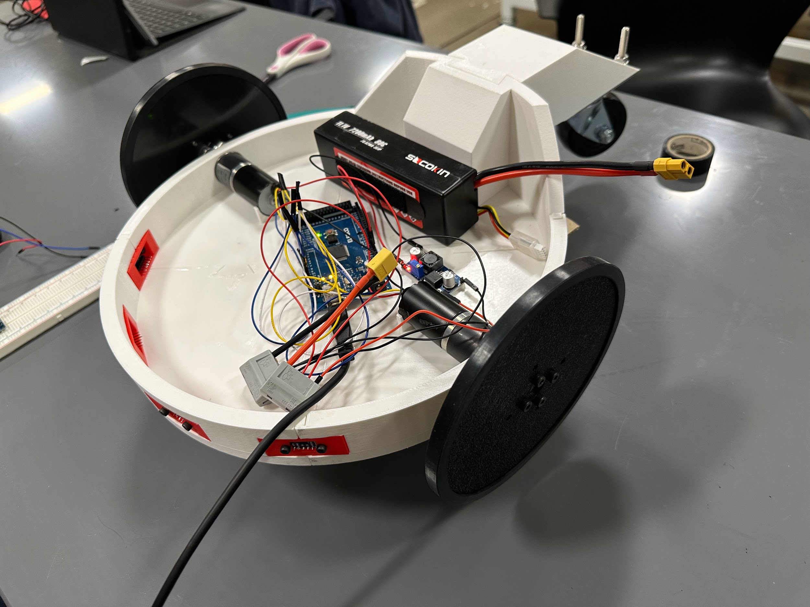
Work in progress prototype
Notes:
dylan

Slide 10
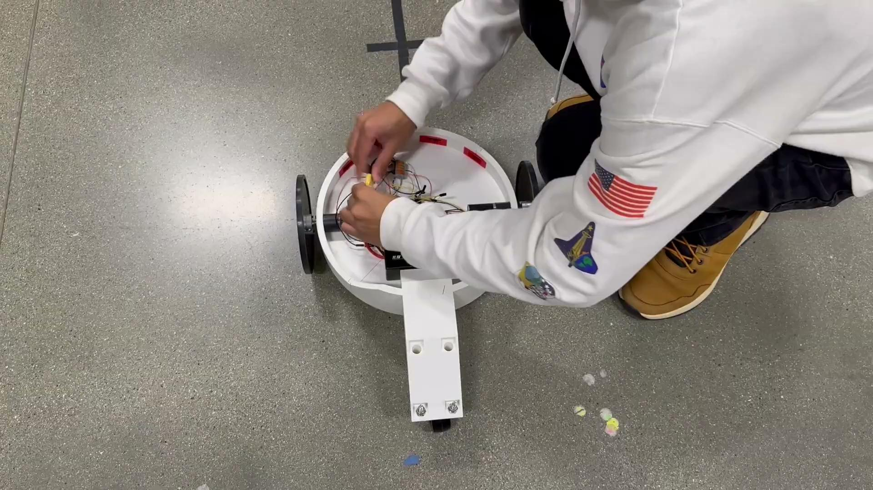
Work in progress prototype
Notes:
dylan

Slide 11
Next Steps
Continue to work on PID
Research
Application
Testing sensors interface
ToF sensors with object detection and avoidance
Iron out any changes for the final design
Notes:
Sam

